Slide 1
Programming Assignment #3
Operating System
201732831 Oh hyeonho 오현호
dhgusgh123@naver.com

Slide 2
Architecture
It was written in C, but it was designed in an object-oriented way.
Part of the functions required in this project is delegated to each struct, and the functions are implemented through a function that receives each struct as an argument, and then combined with each other.

Slide 3
Process
typedef struct Process {
uint8_t pid;
uint8_t priority;
uint64_t arrivalTime;
uint64_t burstTime;
uint64_t initialRunningTime;
uint64_t notRunningSince;
uint64_t remainingBurstTime;
} Process;
typedef struct ProcessNode {
Process *process;
struct ProcessNode *prev;
struct ProcessNode *next;
} ProcessNode;
typedef struct ProcessQueue {
ProcessNode *head;
ProcessNode *tail;
size_t size;
} ProcessQueue;
Implement a struct similar to the PCB that shows the execution state of the process, and create a Doubly linked list containing it and call it ProcessQueue.
The field indicating the current state of the process is not separately implemented, but the state of an arbitrary process can be determined by synthesizing the values of each field.

Slide 4
Context
typedef struct Context {
ProcessQueue jobQueue;
ProcessQueue readyQueue;
Process *currentProcess;
uint64_t elapsedTime;
uint64_t currentProcessStartTime;
} Context;
It is a data structure to express the overall execution state of the scheduling algorithm.

Slide 5
Scheduler
typedef struct Scheduler {
Process *(*whatToStart)(const Context *ctx, void *data);
int (*whetherToStop)(const Context *ctx, void *data);
void *data;
} Scheduler;
It is a struct to abstract and represent various scheduling algorithms.
When will the scheduling algorithm fundamentally cause context switching? And what to run next?
Since it tis all about making the decision to do, we implemented the Scheduler struct to store the pointers of the functions implementing the two logics together.
In the above Signature, void 8dta exists for Round Robin to pass parameters to algorithms such as Preemptive priority with aging.

Slide 6
Dispatcher
typedef struct Dispatcher {
Context context;
const Scheduler *scheduler;
} Dispatcher;
It is a struct to display information about the current execution status while changing context through the scheduler.
Dispatcher::step
int step(Dispatcher *dispatcher, ProcessQueue *finishedProcesses, FILE *output_file);
For each execution, the current Dispatcher performs scheduling for a unit time (1ms in the specification of this project), and if there is a process that has been completed in the process, it is added to finishedProcesses, and the execution log is printed to output_file.

Slide 7
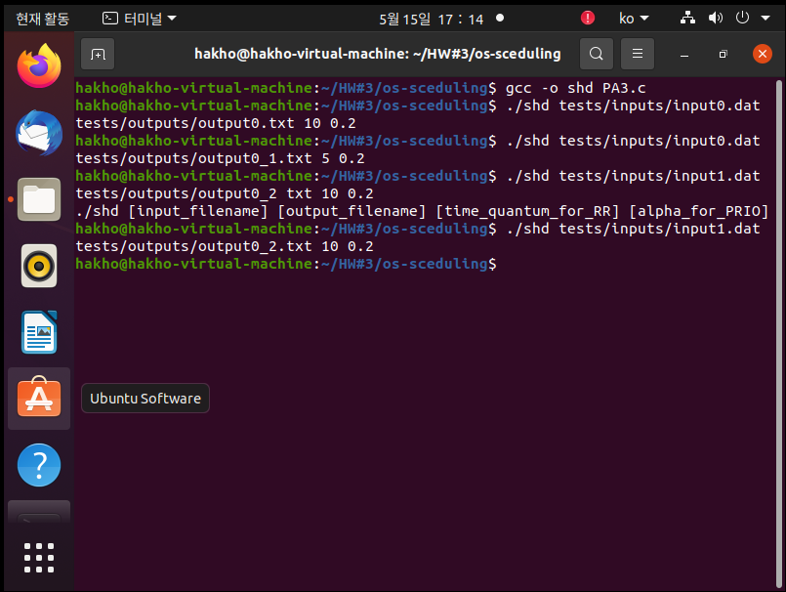
Compile & Run
1. Only different time quantum in the same input file
2. If an input error occurs, a message is displayed -defensive coding
3. Different input files for the same input settings

Slide 8
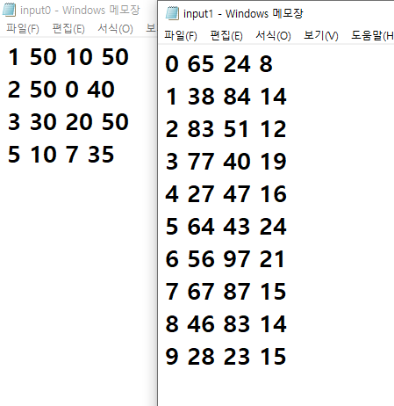
Result
Two input files
Input0.dat
Input1.dat

Slide 9
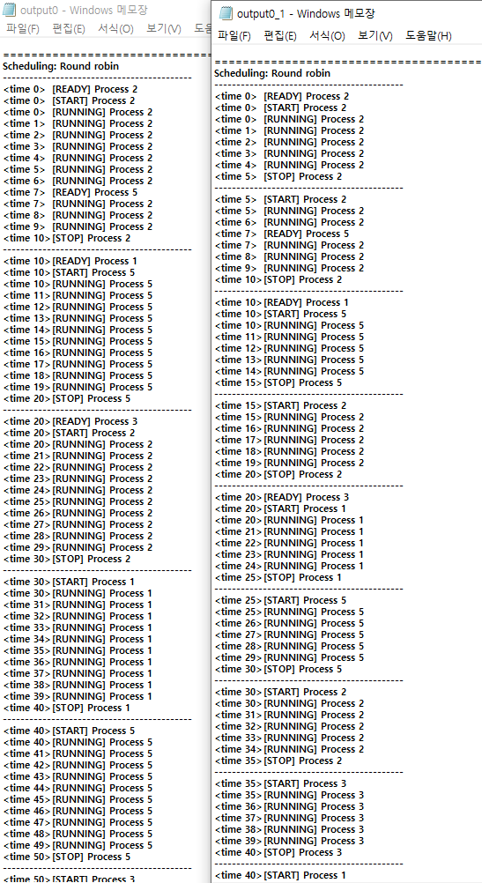
Result
Only different time quantum in the same input file
Input0.dat output0 10 0.2
Input0.dat output0_1 5 0.2
You can see that it is executed at different intervals according to the time quantum.

Slide 10
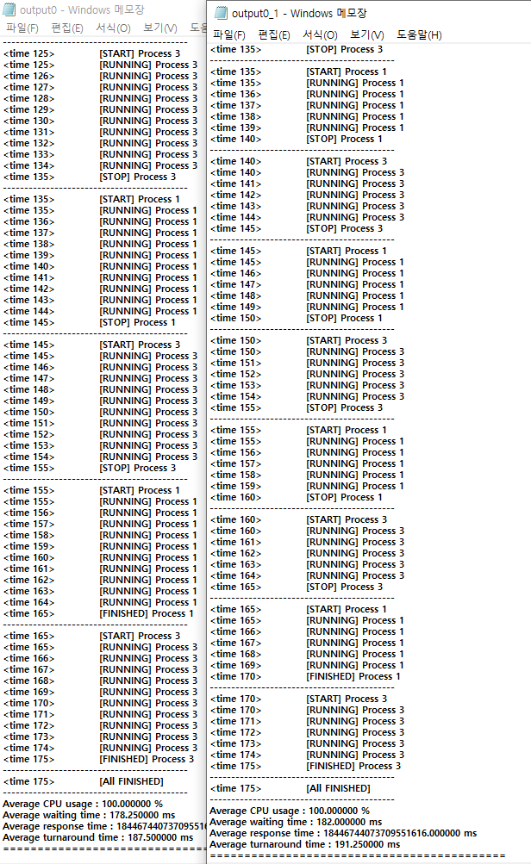
Result
Only different time quantum in the same input file
Input0.dat output0 10 0.2
Input0.dat output0_1 5 0.2
You can see that Average waiting time and Average turnaround time are also different.

Slide 11
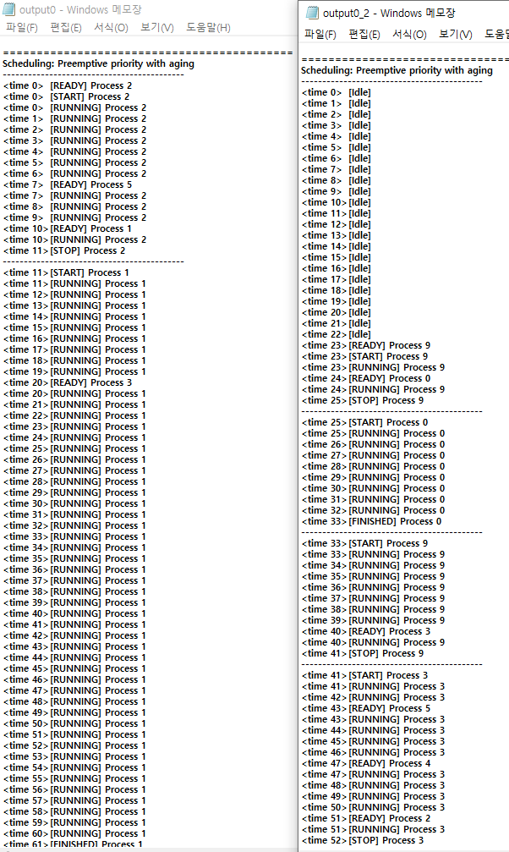
Result
Different input files for the same input settings
Input0.dat output0 10 0.2
Input1.dat output0_2 10 0.2
Since the input file is different, it proceeds completely differently.

Slide 12
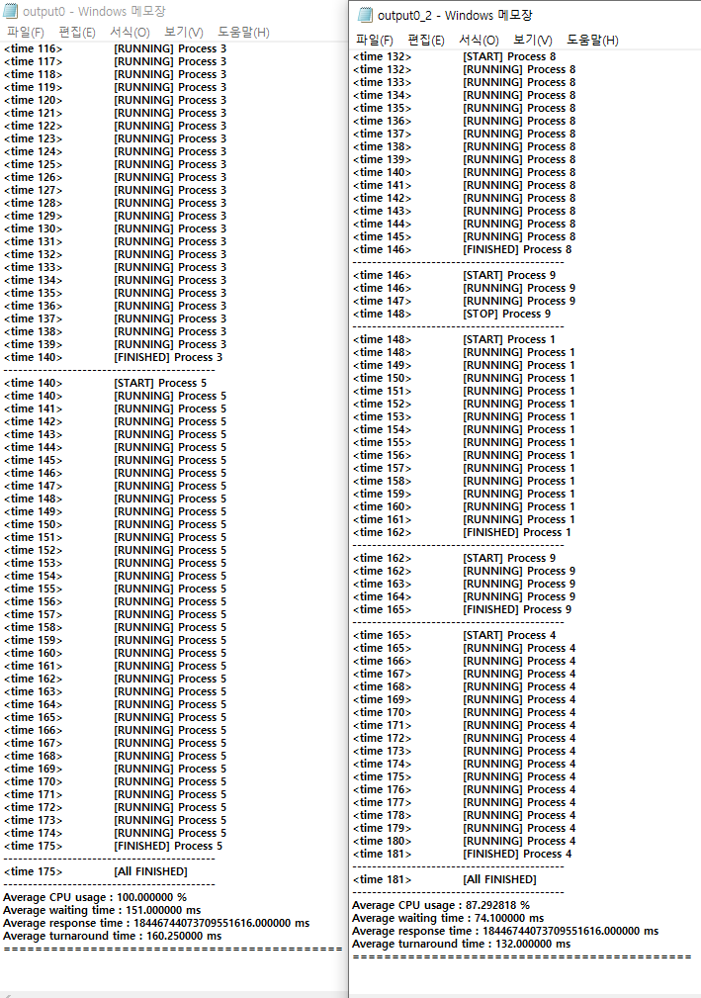
Result
Different input files for the same input settings
Input0.dat output0 10 0.2
Input1.dat output0_2 10 0.2
The results are also completely different.

Slide 13
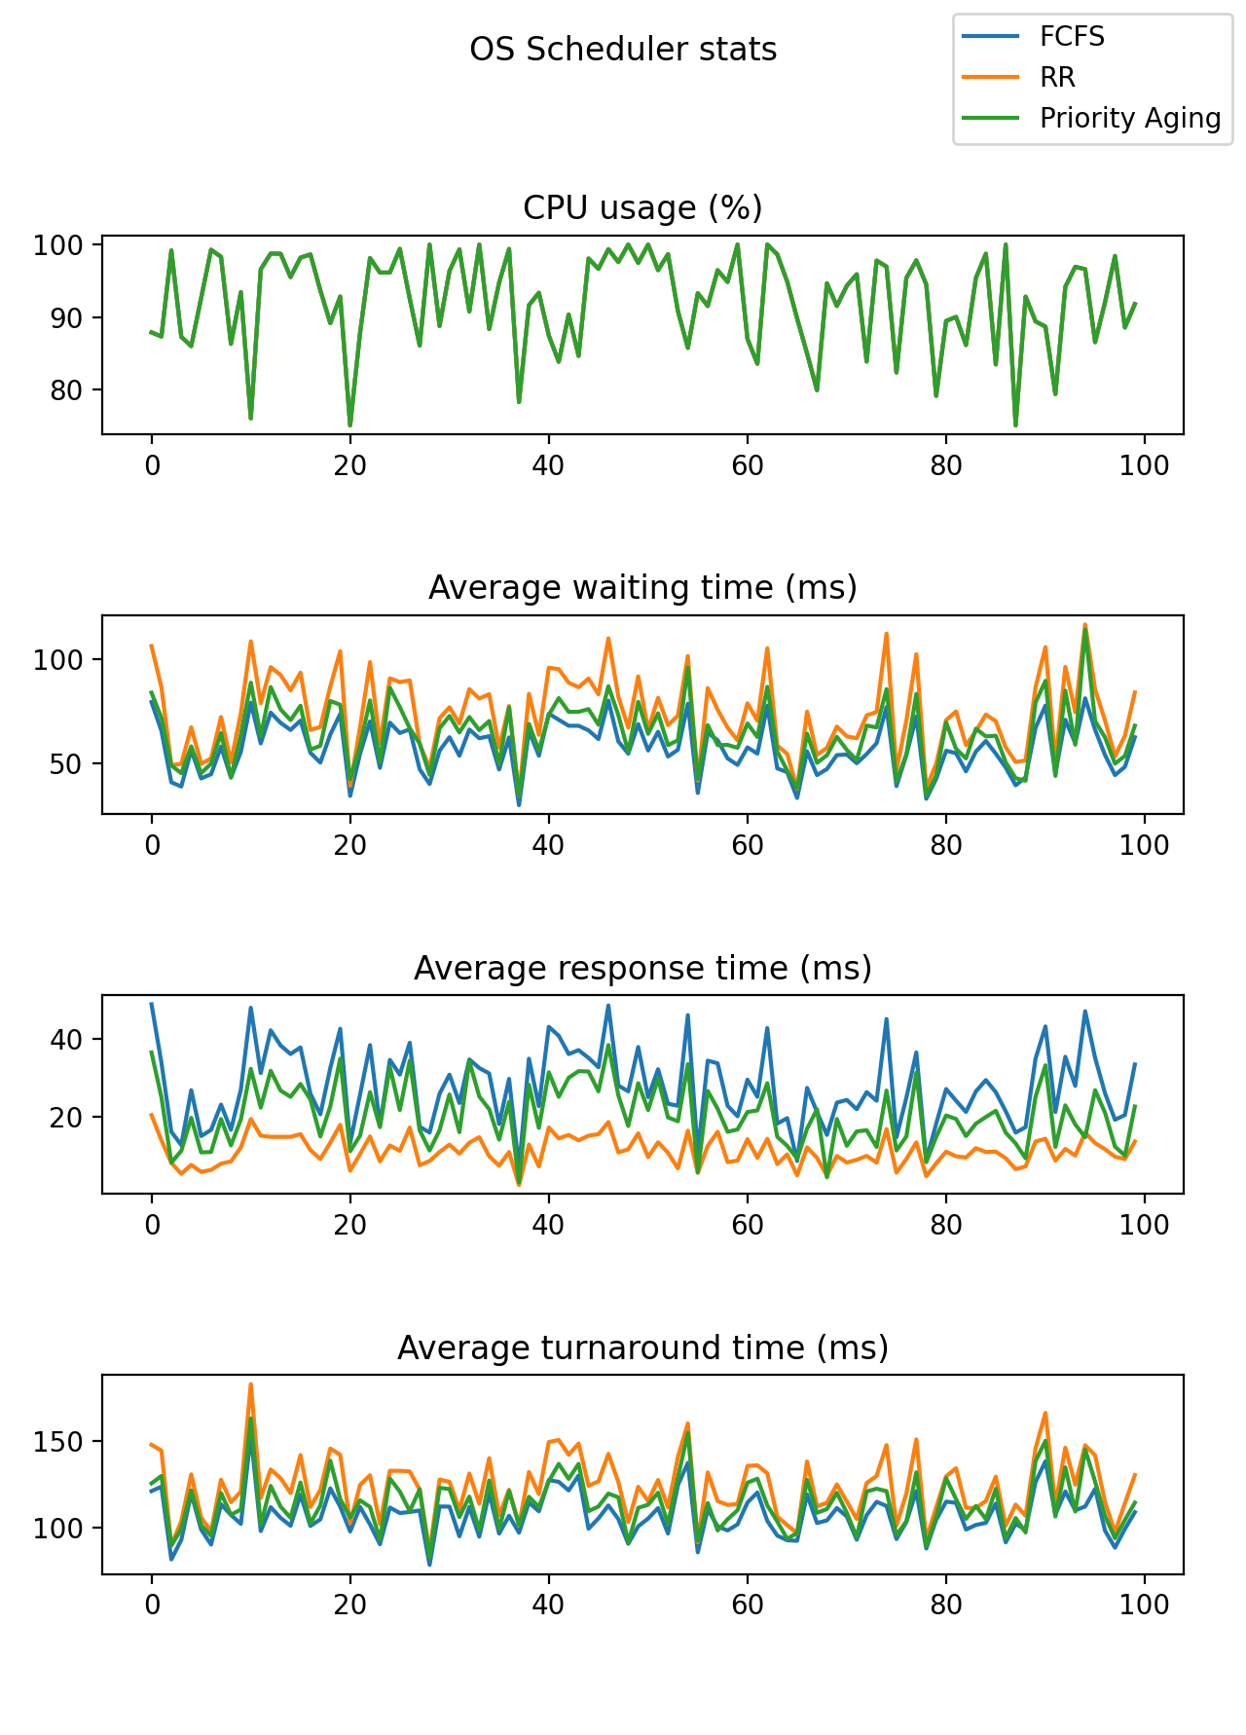
Performance Result
100 test cases were randomly generated and the average statistics were plotted.
(Time quantum = 5,
Aging multiplier = 0.0~1.0)

Slide 14
Performance Result
FCFS: A relatively high waiting time, a relatively low response time, and a turnaround time (compared to Round Robin) were confirmed.
Round robin: A relatively high response time and turnaround time (compared to FCFS) and a relatively low waiting time were confirmed.Preemptive
priority with aging: All three metrics showed figures between FCFS and Round Robin. As the aging multiplier was adjusted, the degree close to FCFS and RR changed. In the input generated for this report, the aging multiplier tended to be closer to the RR as the aging multiplier increased.

Slide 15
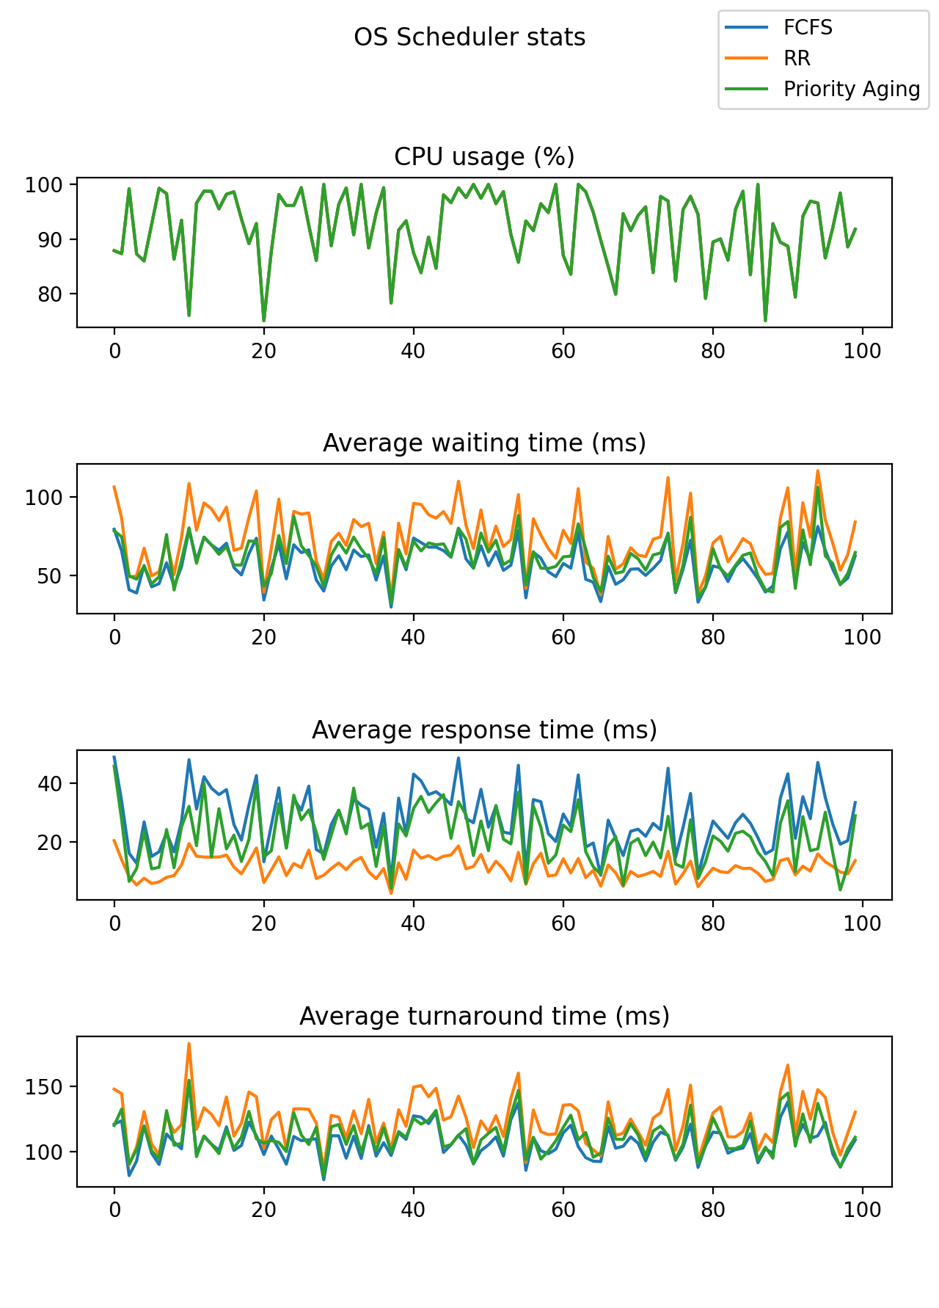
Performance Result Graph
Time quantum = 5 Aging multiplier = 0.0

Slide 16
Performance Result Graph
Time quantum = 5 Aging multiplier = 0.1

Slide 17
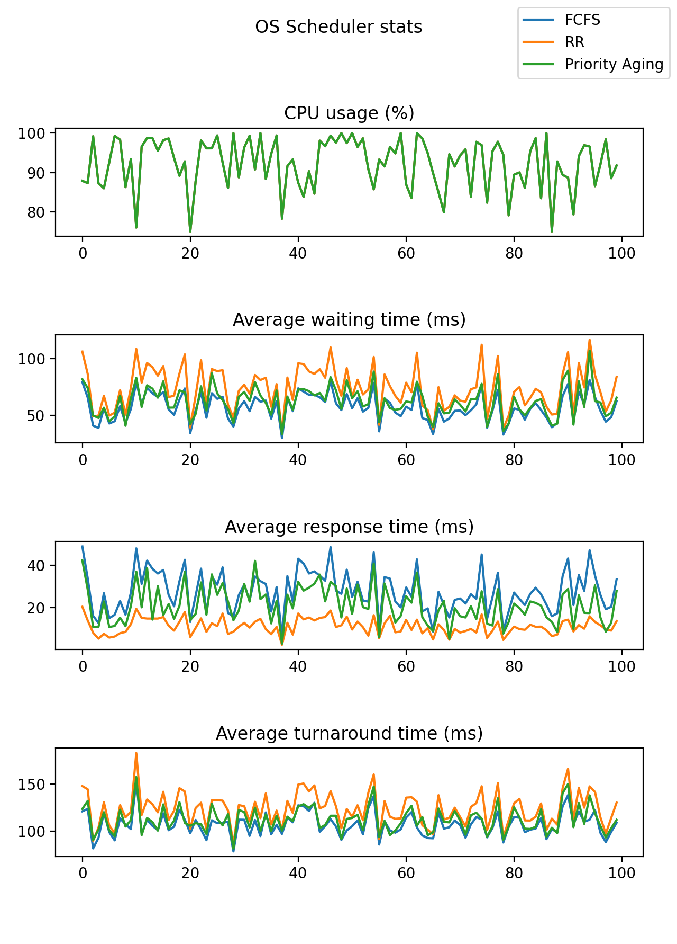
Performance Result Graph
Time quantum = 5 Aging multiplier = 0.2

Slide 18
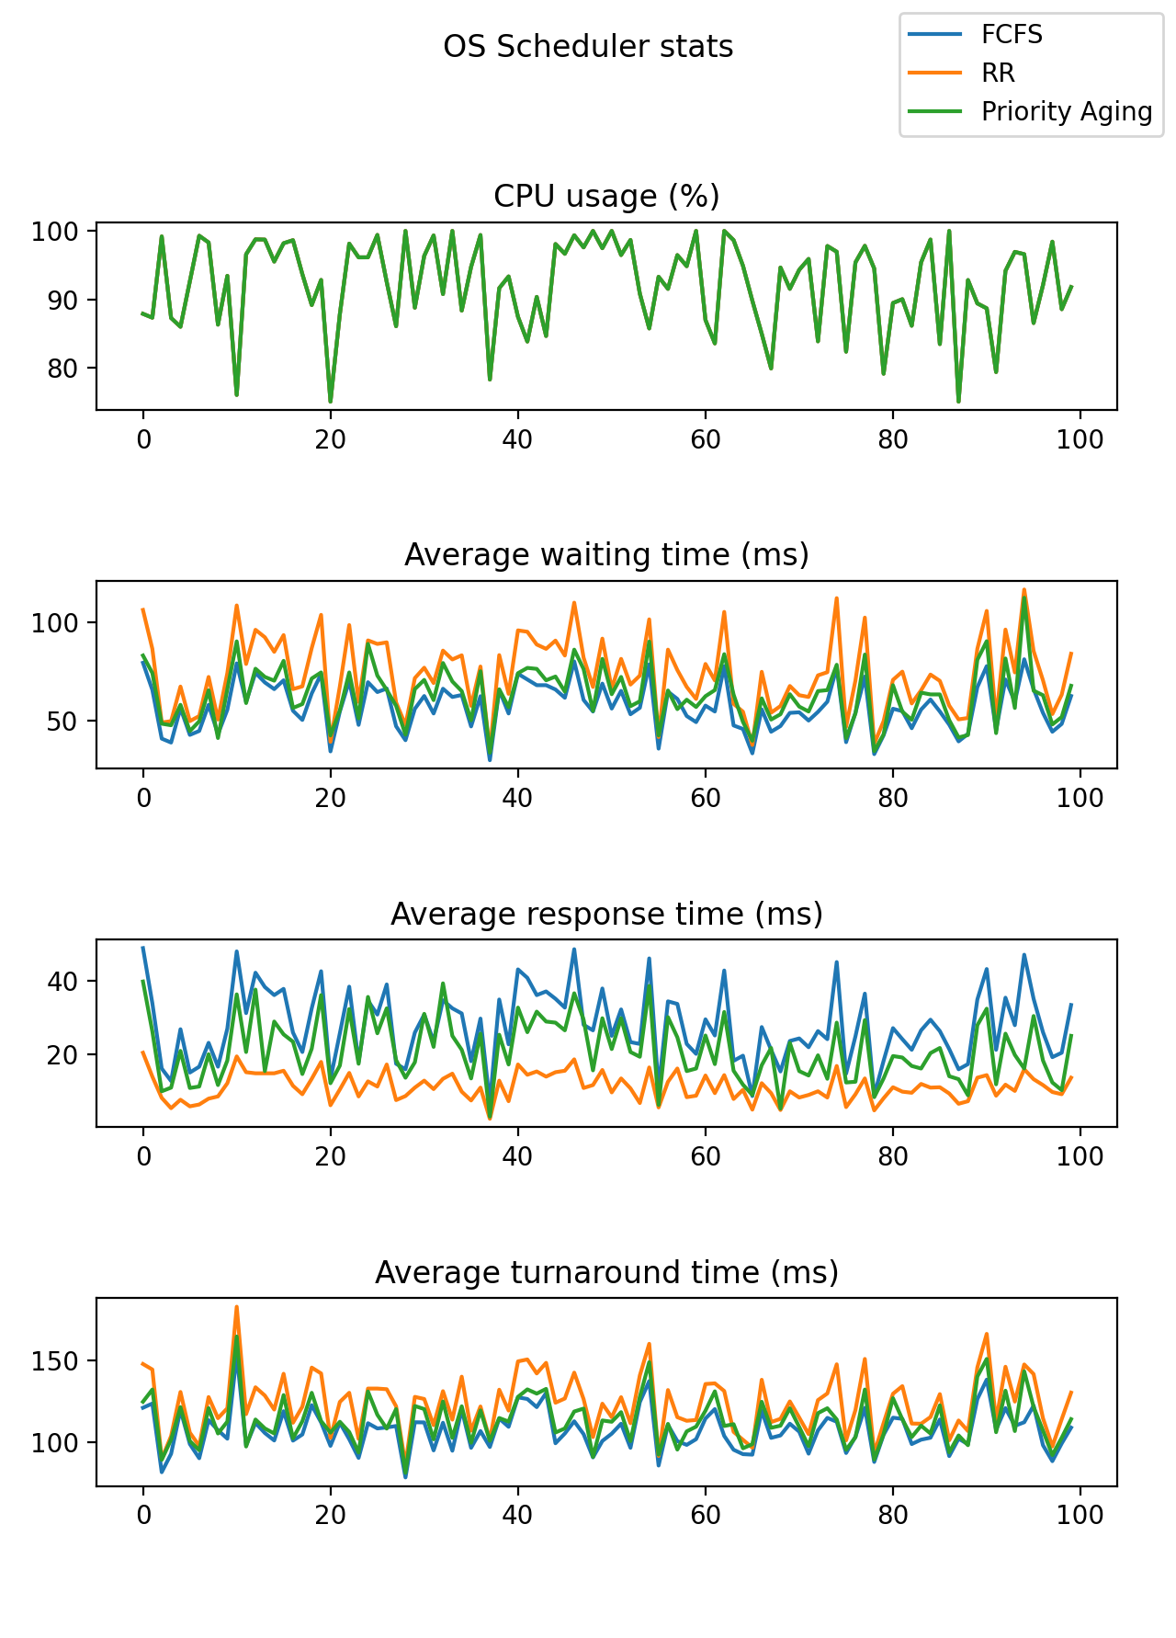
Performance Result Graph
Time quantum = 5 Aging multiplier = 0.5

Slide 19
Performance Result Graph
Time quantum = 5 Aging multiplier = 1.0

